Slide 1
k-dTrees

Slide 2
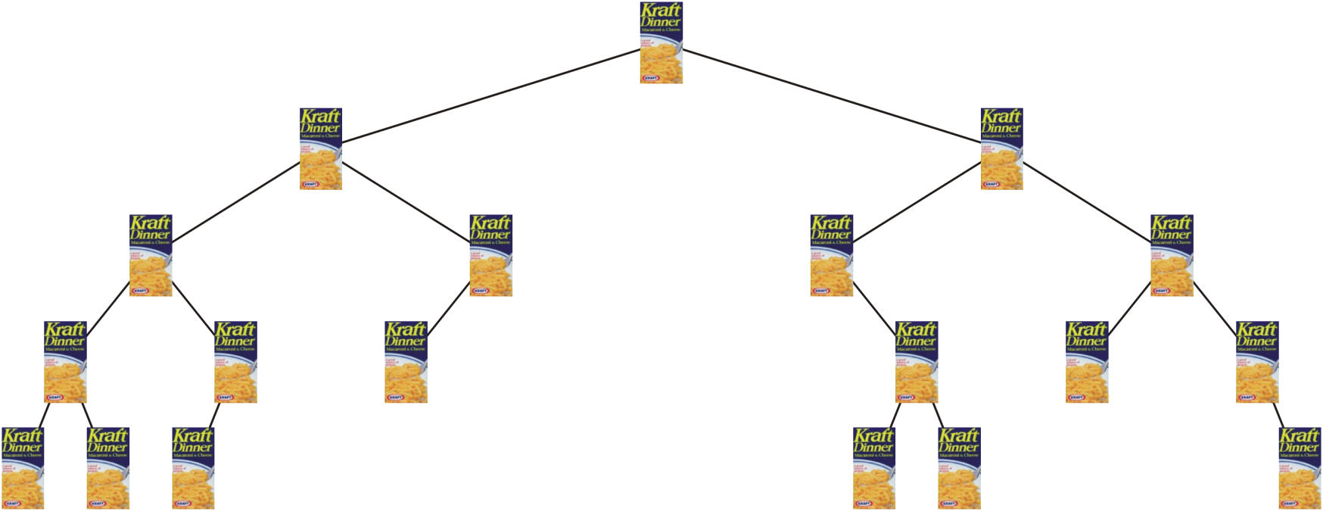
k-d trees
This may be a “KD” tree, but it is not a k-d tree
http://www.kraft.com/

Slide 3
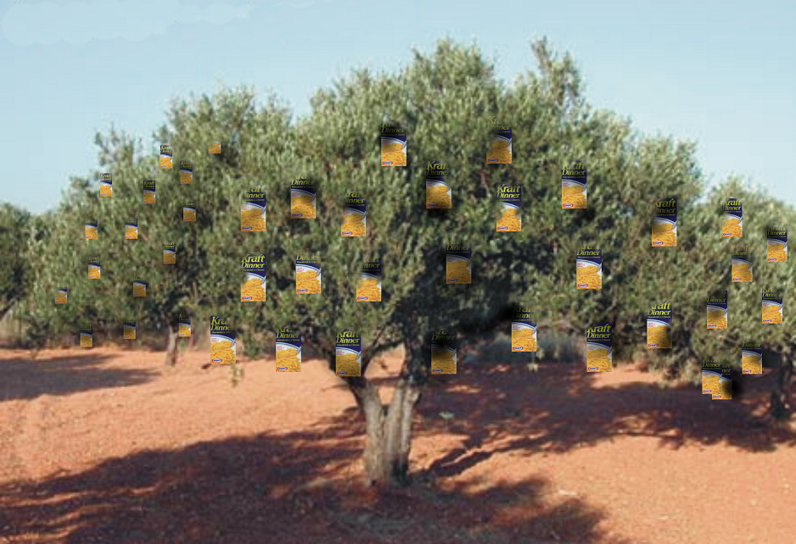
k-d trees
In a vain attempt to mass-produce and improve their product, Kraft considers genetic engineering...
This is not a k-d tree, either
my apologies to http://www.explorecrete.com/

Slide 4
Outline
In this topic, we will cover:
The idea behind a k-d tree
Partitioning points in a k-dimensional space
How sub-trees restrict the region of its elements
Counting elements, searching, insertions, and nearest neighbour
Difficulties with removals and balancing
Other applications

Slide 5
k-d trees
Used in image processing as a means of partitioning points in a k-dimensional space
Binary search trees are excellent at storing and searching data 1-dimensional (i.e., linear) space

Slide 6
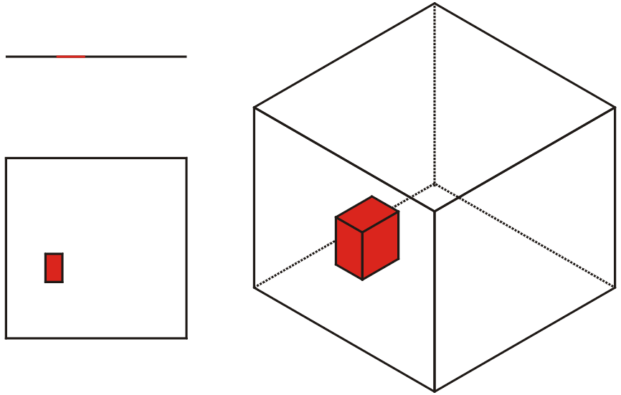
k-d trees
As these examples demonstrate:
with binary trees, it is easy to find all points which fall inside a given interval (a 1d box)
how do we store points so that we can find all points which fall within a
rectangle (a 2d box), or
a 3d box?

Slide 7
k-d trees
To solve this problem, we will define a binary tree where
depths 0, k, 2k, etc., contain binary search nodes sorted on the 1st coordinate
depths 1, k + 1, 2k + 1, etc., contain binary search nodes nodes sorted on the 2nd coordinate,
and in general
depths j, k + j, 2k + j, etc., contain binary search nodes sorted on the (k + 1)^{st} coordinate

Slide 8
k-d trees
Comment on the naming convention:
while the k refers to the dimension, it is common to refer to such a tree as, for example, a 3-dimensional k-d tree instead of a 3-d tree, as numerous data structures could be referred to as 3-d trees

Slide 9
k-d trees
Given a set of points, we can construct a balanced k-d tree by always using the median element with respect the coordinate being searched on
We will assume no duplication, but if duplication occurs, we can choose any of the median elements

Slide 10
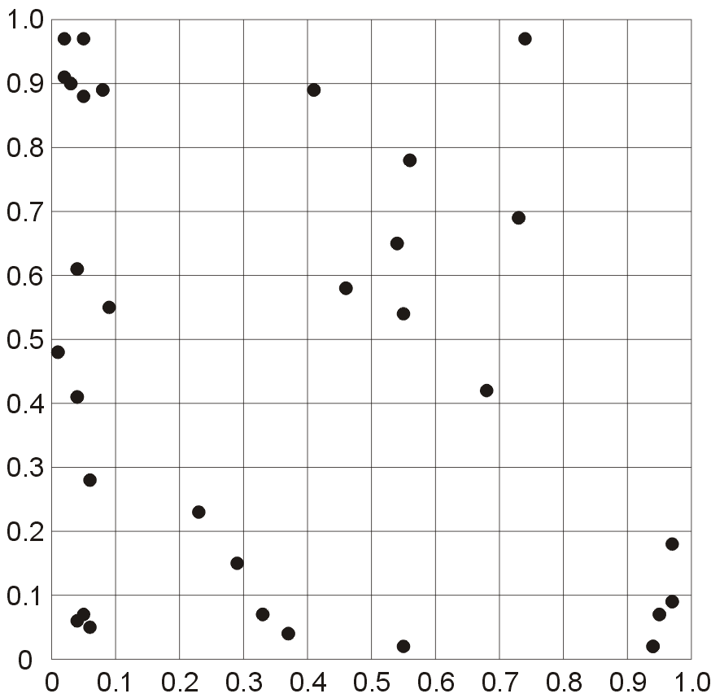
k-d trees
Suppose we wish to partition the following points in a 2-dimensional k-d tree:
(0.03, 0.90), (0.37, 0.04), (0.56, 0.78), (0.01, 0.48), (0.41, 0.89), (0.95, 0.07), (0.97, 0.09), (0.54, 0.65), (0.04, 0.61), (0.73, 0.69), (0.46, 0.58), (0.08, 0.89), (0.04, 0.41), (0.94, 0.02), (0.33, 0.07), (0.55, 0.54), (0.06, 0.05), (0.04, 0.06), (0.74, 0.97), (0.29, 0.15), (0.05, 0.88), (0.23, 0.23), (0.55, 0.02), (0.02, 0.97), (0.05, 0.07), (0.06, 0.28), (0.09, 0.55), (0.02, 0.91), (0.05, 0.97), (0.68, 0.42), (0.97, 0.18)

Slide 11
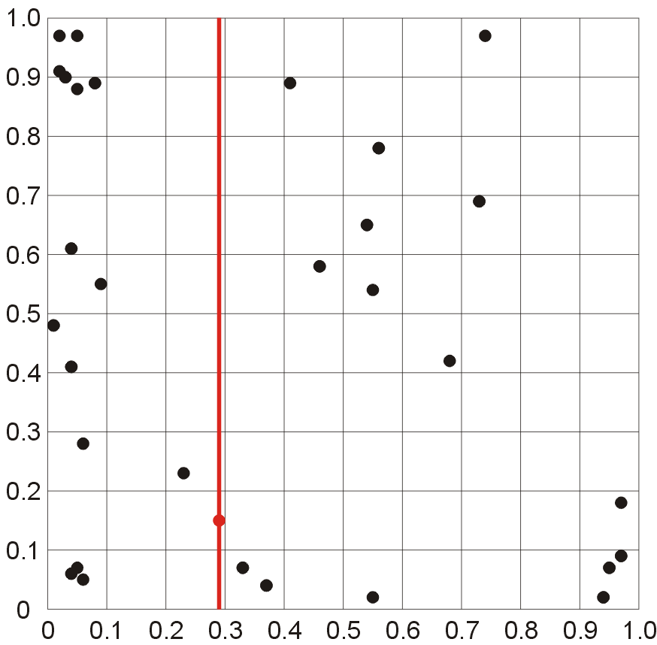
k-d trees
The first step is to order the points based on the 1st coordinate and find the median:
(0.01, 0.48), (0.02, 0.91), (0.02, 0.97), (0.03, 0.90),
(0.04, 0.06), (0.04, 0.41), (0.04, 0.61), (0.05, 0.07),
(0.05, 0.88), (0.05, 0.97), (0.06, 0.05), (0.06, 0.28),
(0.08, 0.89), (0.09, 0.55), (0.23, 0.23), (0.29, 0.15),
(0.33, 0.07), (0.37, 0.04), (0.41, 0.89), (0.46, 0.58),
(0.54, 0.65), (0.55, 0.02), (0.55, 0.54), (0.56, 0.78),
(0.68, 0.42), (0.73, 0.69), (0.74, 0.97), (0.94, 0.02),
(0.95, 0.07), (0.97, 0.09), (0.97, 0.18)

Slide 12

k-d trees
The median point, (0.29, 0.15), forms the root of our k-d tree

Slide 13
k-d trees
This partitions the remaining points into two sets:
{(0.01, 0.48), (0.02, 0.91), (0.02, 0.97), (0.03, 0.90),
(0.04, 0.06), (0.04, 0.41), (0.04, 0.61), (0.05, 0.07),
(0.05, 0.88), (0.05, 0.97), (0.06, 0.05), (0.06, 0.28),
(0.08, 0.89), (0.09, 0.55), (0.23, 0.23)}
{(0.33, 0.07), (0.37, 0.04), (0.41, 0.89), (0.46, 0.58),
(0.54, 0.65), (0.55, 0.02), (0.55, 0.54), (0.56, 0.78),
(0.68, 0.42), (0.73, 0.69), (0.74, 0.97), (0.94, 0.02),
(0.95, 0.07), (0.97, 0.09), (0.97, 0.18)}

Slide 14
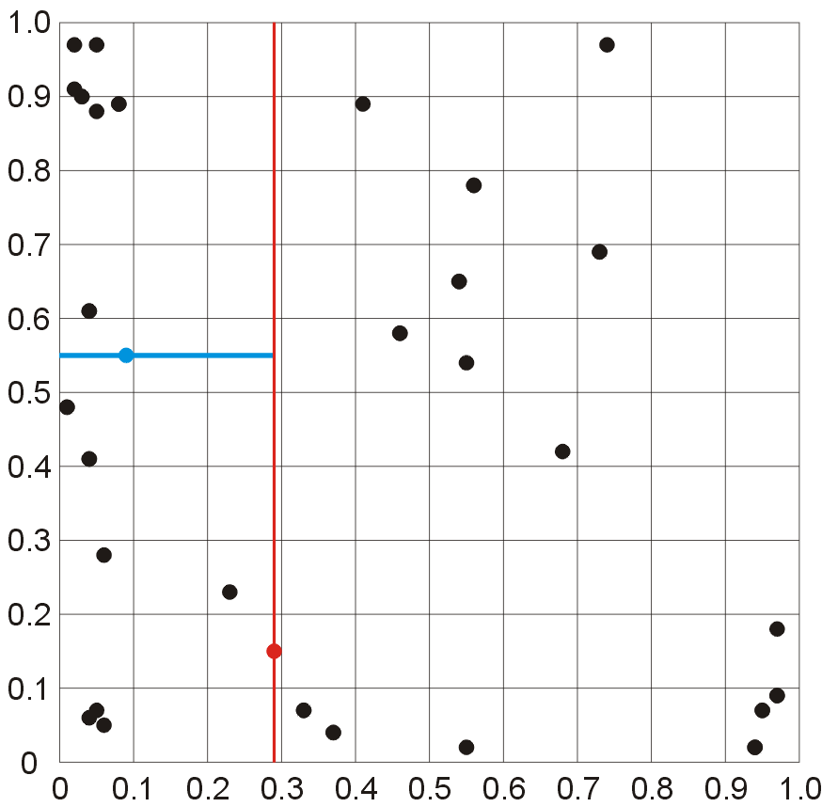

k-d trees
Starting with the first partition, we order these according to the 2nd coordinate:
(0.06, 0.05), (0.04, 0.06), (0.05, 0.07), (0.23, 0.23),
(0.06, 0.28), (0.04, 0.41), (0.01, 0.48), (0.09, 0.55),
(0.04, 0.61), (0.03, 0.90), (0.02, 0.91), (0.02, 0.97),
(0.05, 0.88), (0.08, 0.89), (0.05, 0.97)

Slide 15

k-d trees
This point creates the left child of the root

Slide 16
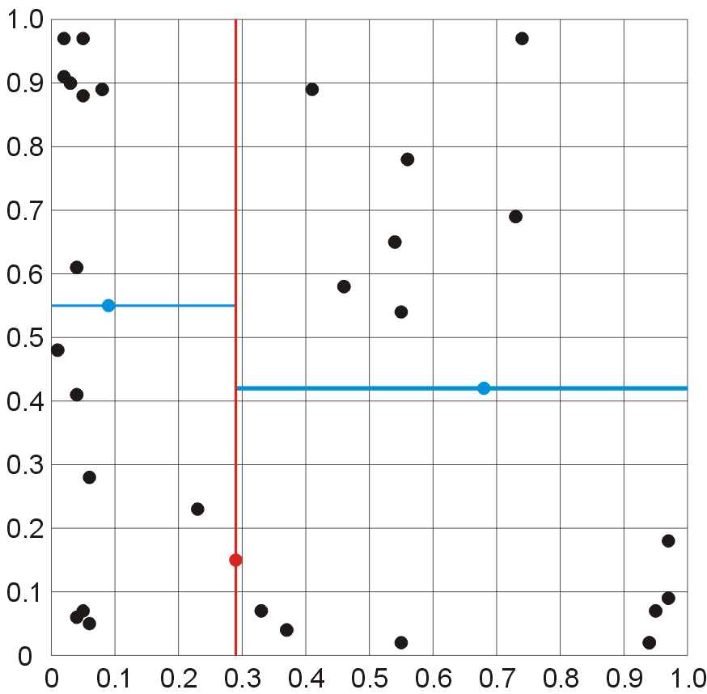

k-d trees
Starting with the second partition, we also order these according to the 2nd coordinate:
(0.55, 0.02), (0.94, 0.02), (0.37, 0.04), (0.33, 0.07),
(0.95, 0.07), (0.97, 0.09), (0.97, 0.18), (0.68, 0.42),
(0.55, 0.54), (0.46, 0.58), (0.54, 0.65), (0.73, 0.69),
(0.56, 0.78), (0.41, 0.89), (0.74, 0.97)

Slide 17

k-d trees
This point creates the right child of the root

Slide 18
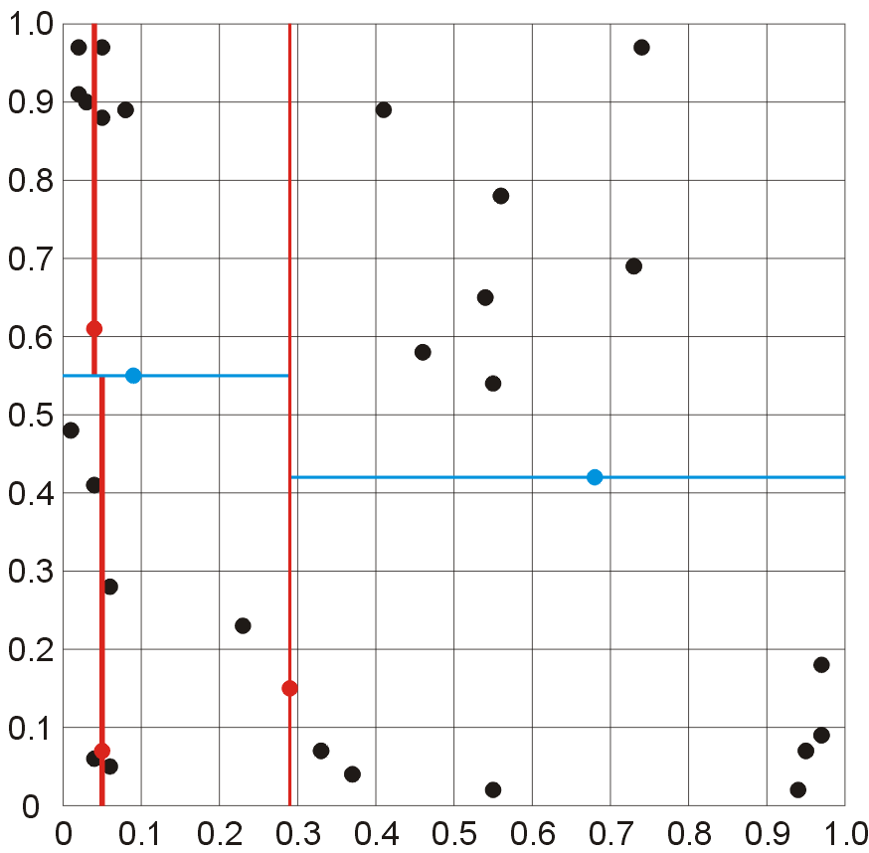
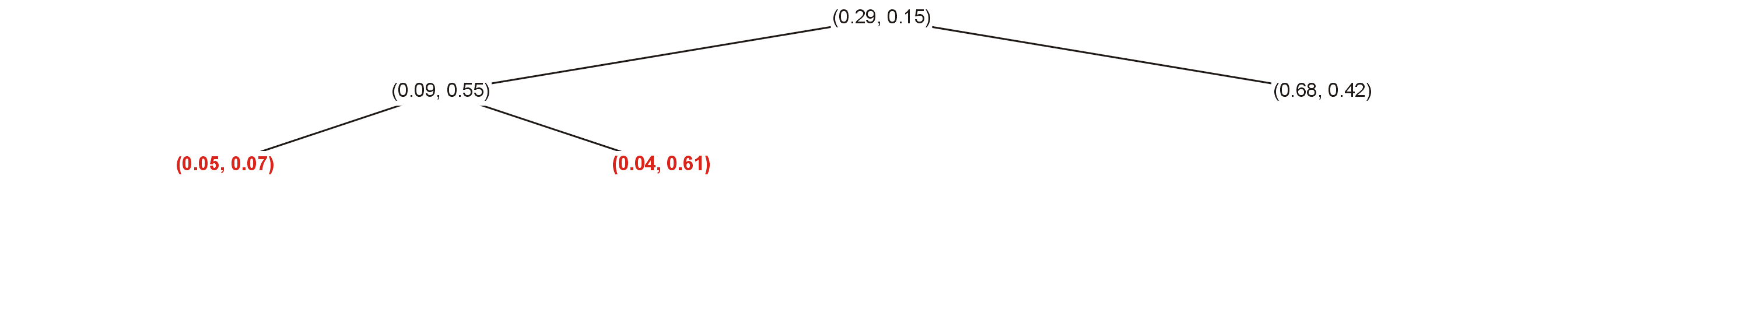
k-d trees
Next, ordering the partitioned elements by the 1st coordinate, we choose the medians to find the children of the left child (0.09, 0.55):
(0.01, 0.48), (0.04, 0.06), (0.04, 0.41), (0.05, 0.07),
(0.06, 0.05), (0.06, 0.28), (0.23, 0.23),
(0.02, 0.91), (0.02, 0.97), (0.03, 0.90), (0.04, 0.61),
(0.05, 0.88), (0.05, 0.97), (0.08, 0.89)

Slide 19
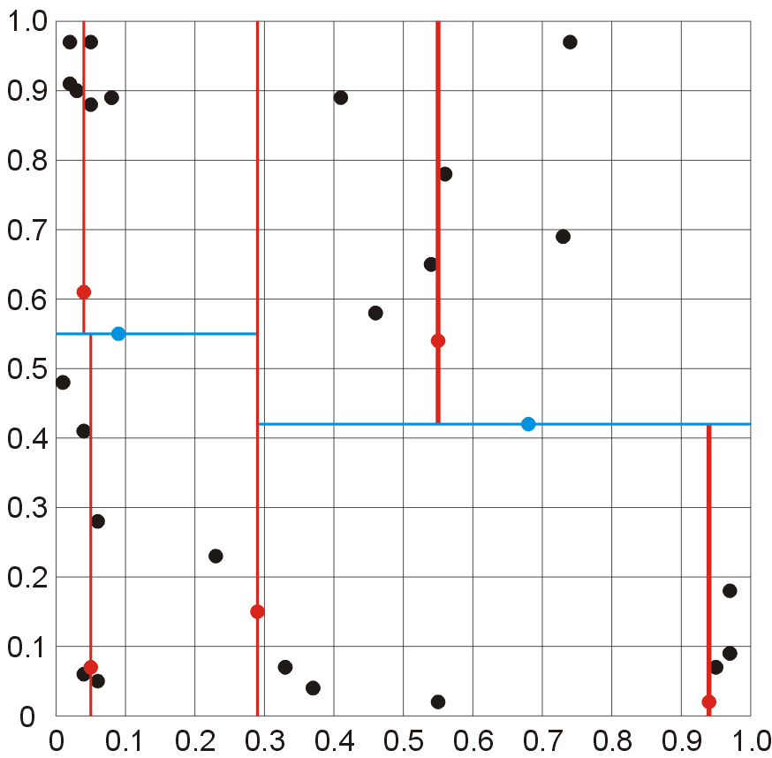
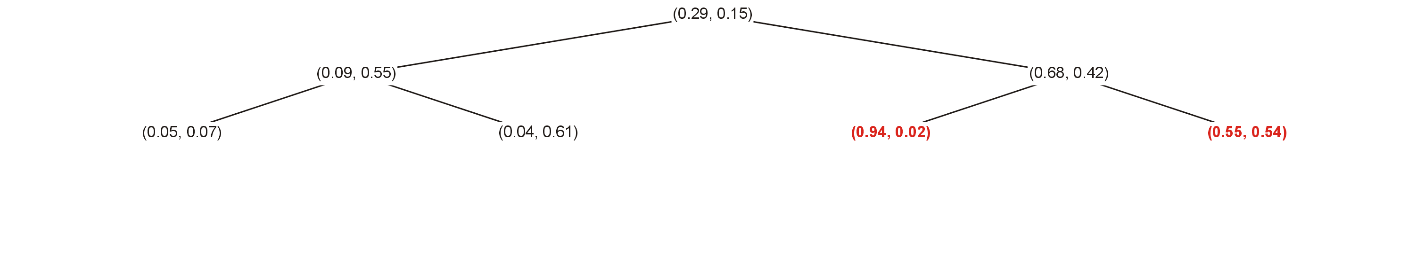
k-d trees
Doing the same with the two right partitions, we get the children of the right child of the root:
(0.33, 0.07), (0.37, 0.04), (0.55, 0.02), (0.94, 0.02),
(0.95, 0.07), (0.97, 0.09), (0.97, 0.18)
(0.41, 0.89), (0.46, 0.58), (0.54, 0.65), (0.55, 0.54),
(0.56, 0.78), (0.73, 0.69), (0.74, 0.97)

Slide 20
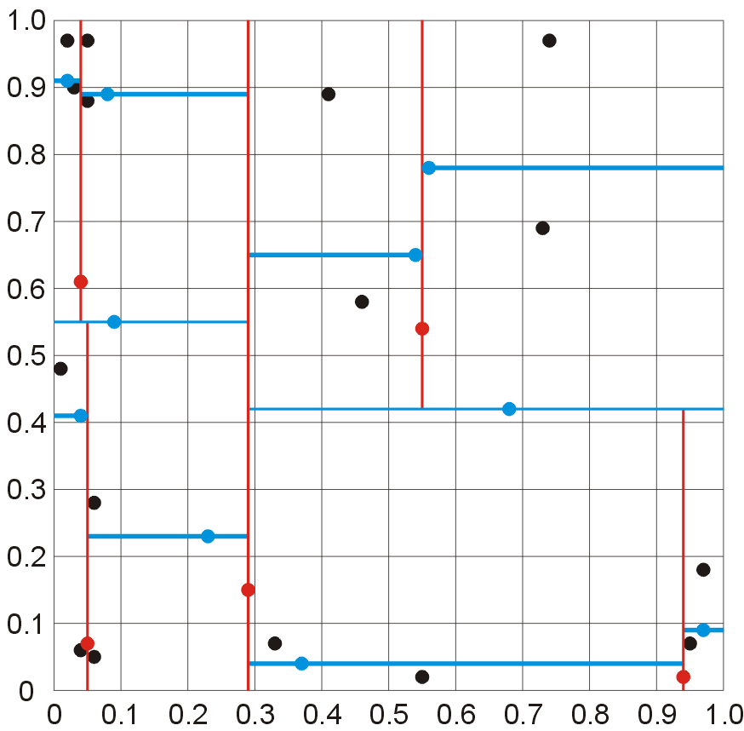
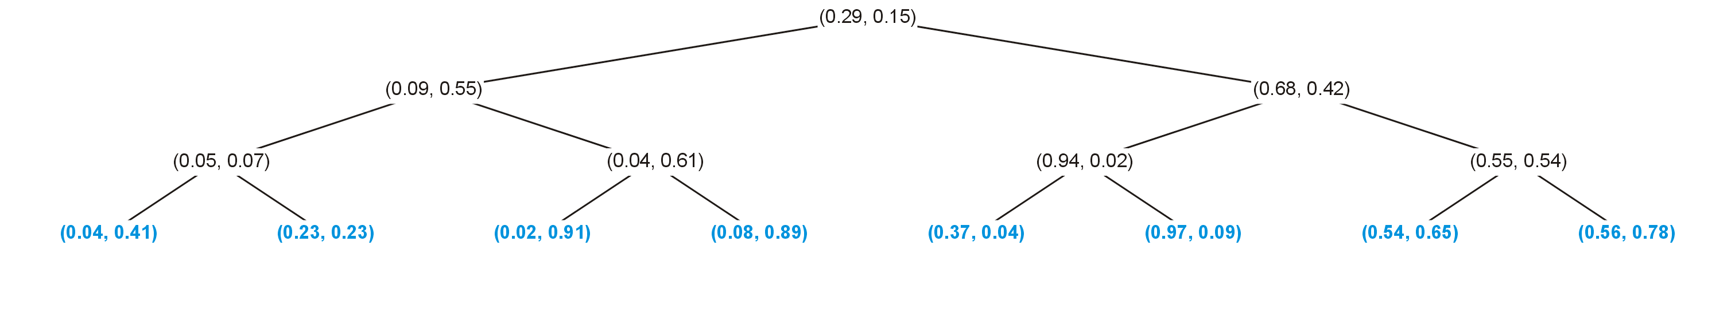
k-d trees
At the next level, we order the points again based on the 2nd coordinate and choose the medians:
(0.04, 0.06), (0.04, 0.41), (0.01, 0.48)
(0.06, 0.05), (0.23, 0.23), (0.06, 0.28)
(0.03, 0.90), (0.02, 0.91), (0.02, 0.97)
(0.05, 0.88), (0.08, 0.89), (0.05, 0.97)
(0.55, 0.02), (0.37, 0.04), (0.33, 0.07)
(0.95, 0.07), (0.97, 0.09), (0.97, 0.18)
(0.46, 0.58), (0.54, 0.65), (0.41, 0.89)
(0.73, 0.69), (0.56, 0.78), (0.74, 0.97)

Slide 21
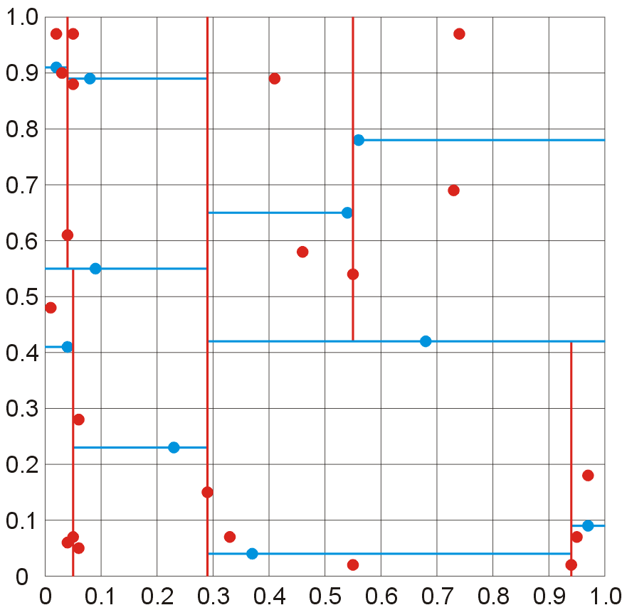
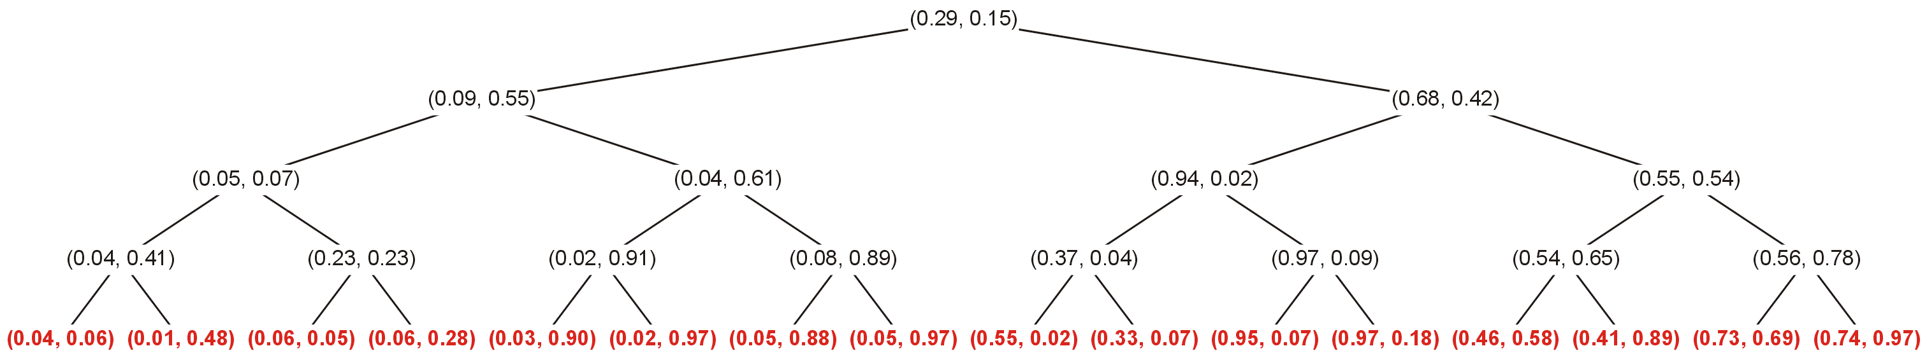
k-d trees
The remaining points fit in their appropriate locations

Slide 22
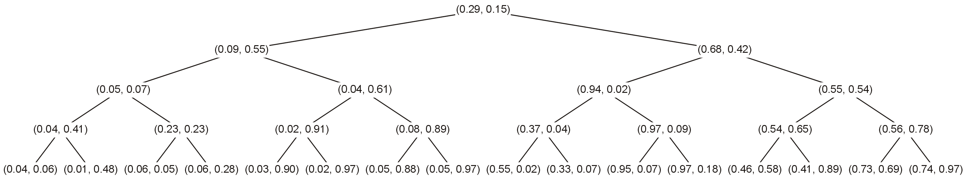
k-d trees
The result is a 2-dimensional k-d tree of the given 31 points

Slide 23
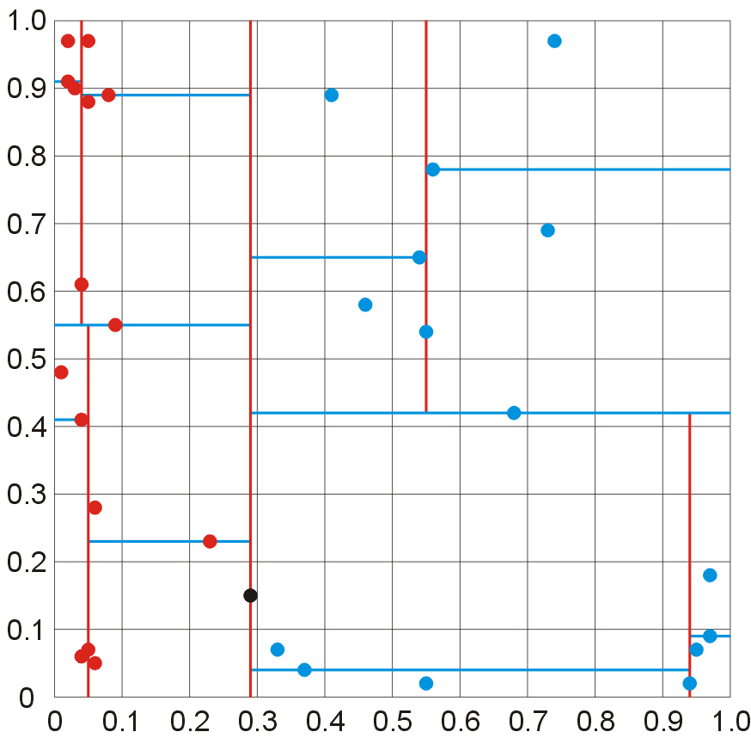
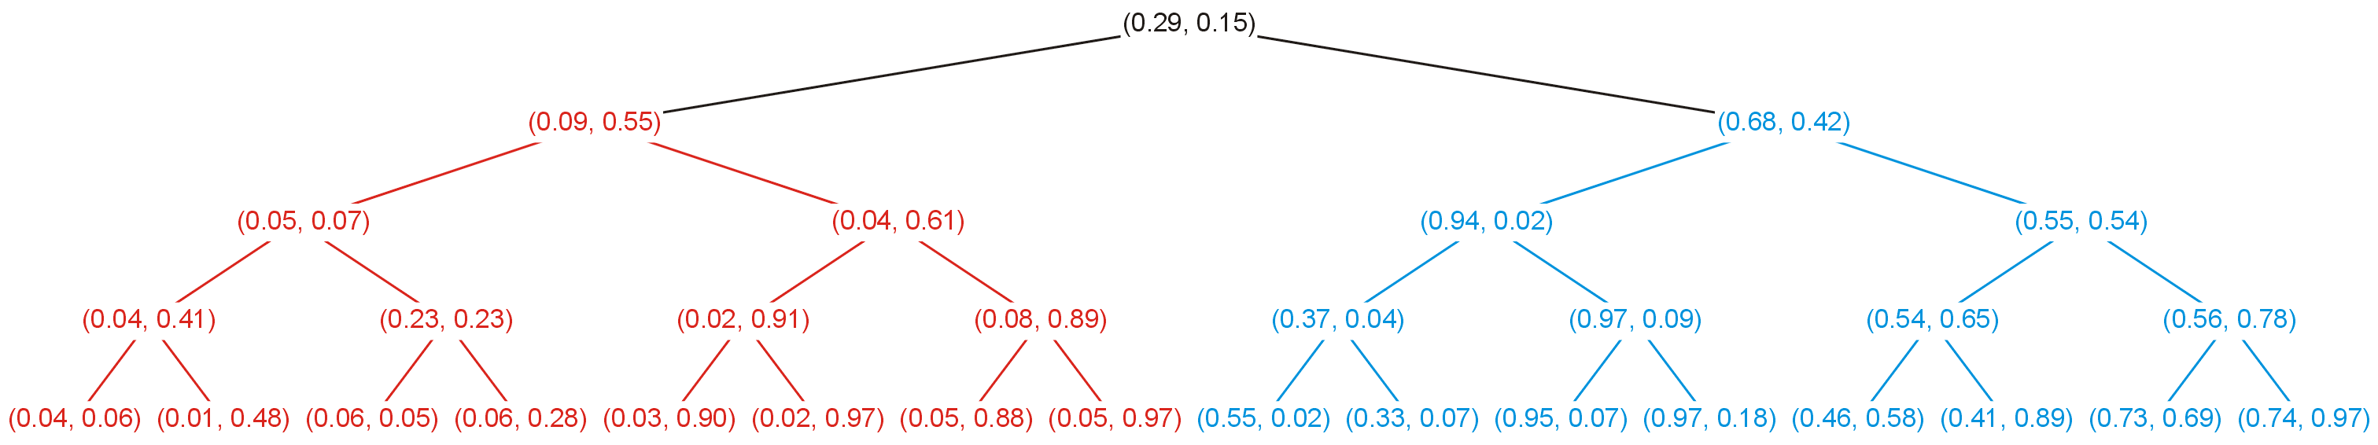
k-d trees
In this example, all points are in the box [0, 1] × [0, 1], however:
all points in the left sub-tree are in the box [0, 0.29] × [0, 1]
all points in the right sub-tree are in the box [0.29, 1] × [0, 1]

Slide 24
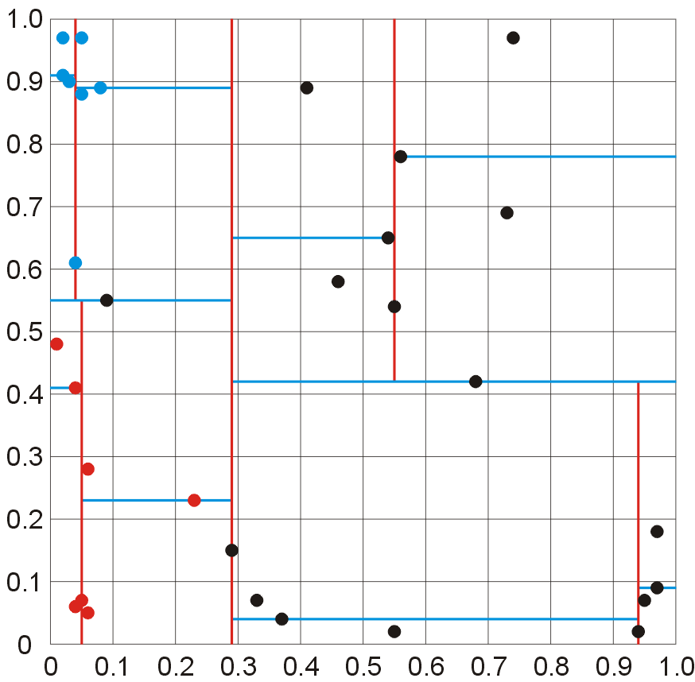
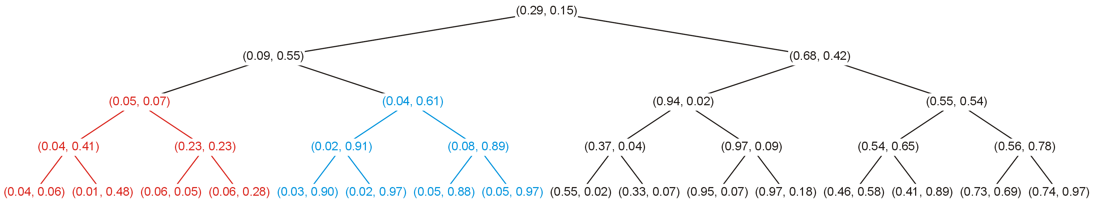
k-d trees
Looking at the left sub-tree, all points fall within [0, 0.29] × [0, 1], and
all points in its left sub-tree are in [0, 0.29] × [0, 0.55]
all points in its right sub-tree are in [0.29, 1] × [0.55, 1]

Slide 25
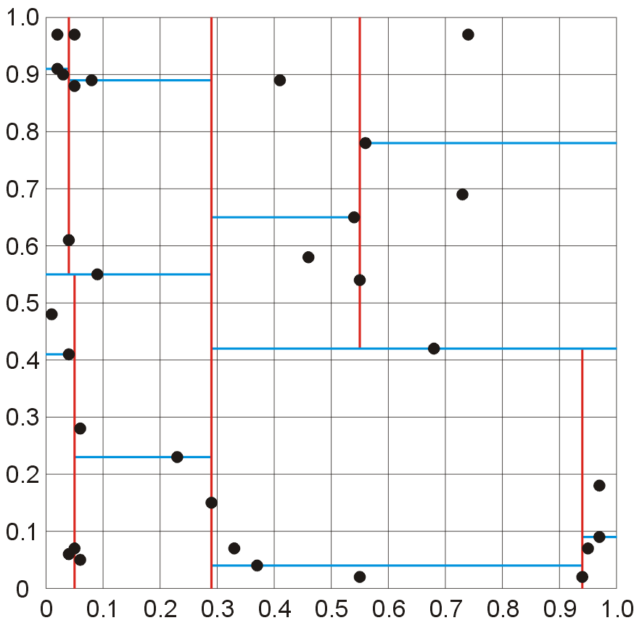
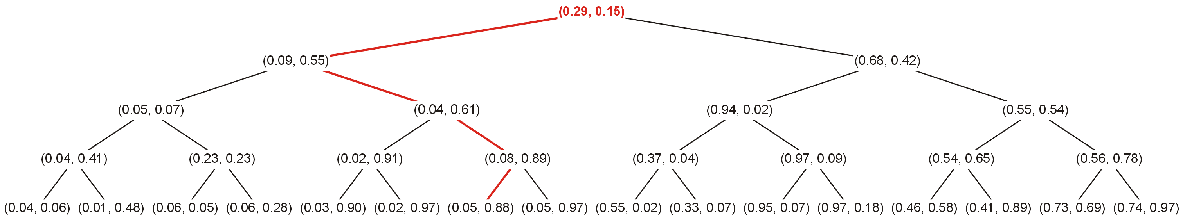
k-d trees
Following paths similarly limits the regions of the points within the sub-trees
In this example we will follow the red path starting at the root

Slide 26
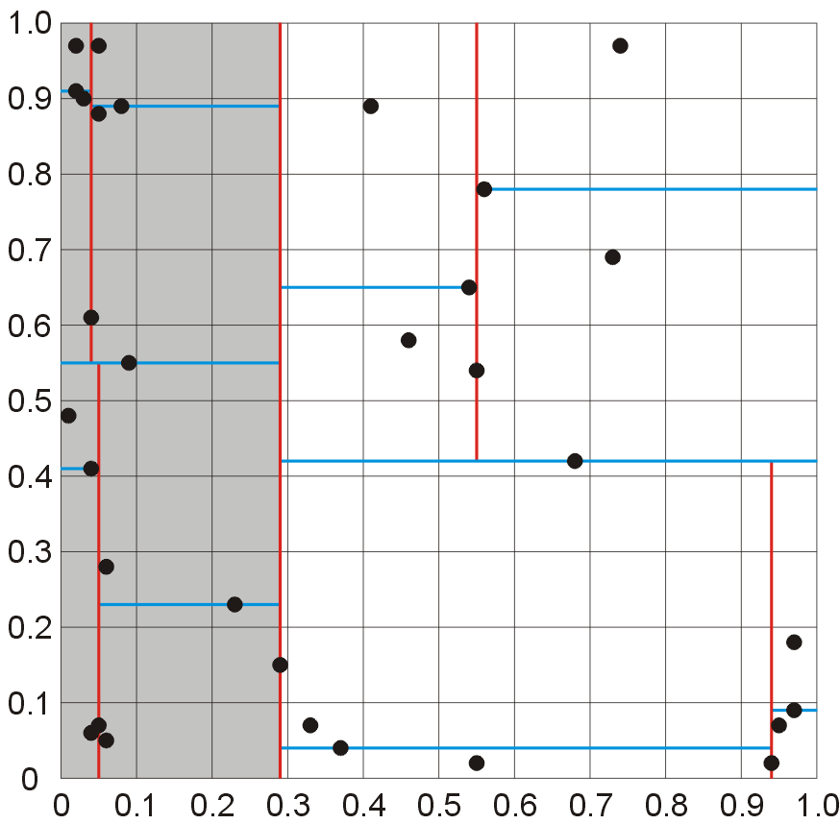
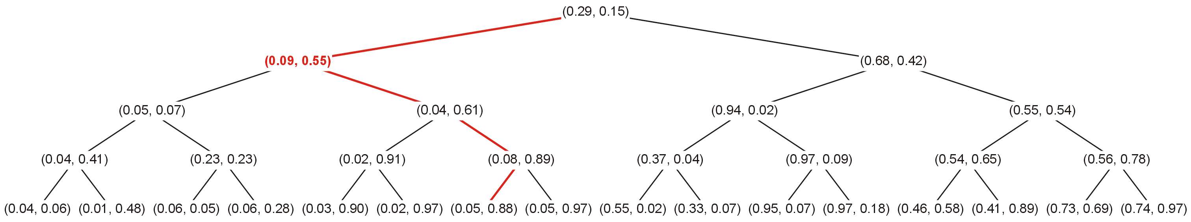
k-d trees
All points with (0.09, 0.55) as its root appear in the shaded area
This region is restricted to [0, 0.29] × [0, 1]

Slide 27
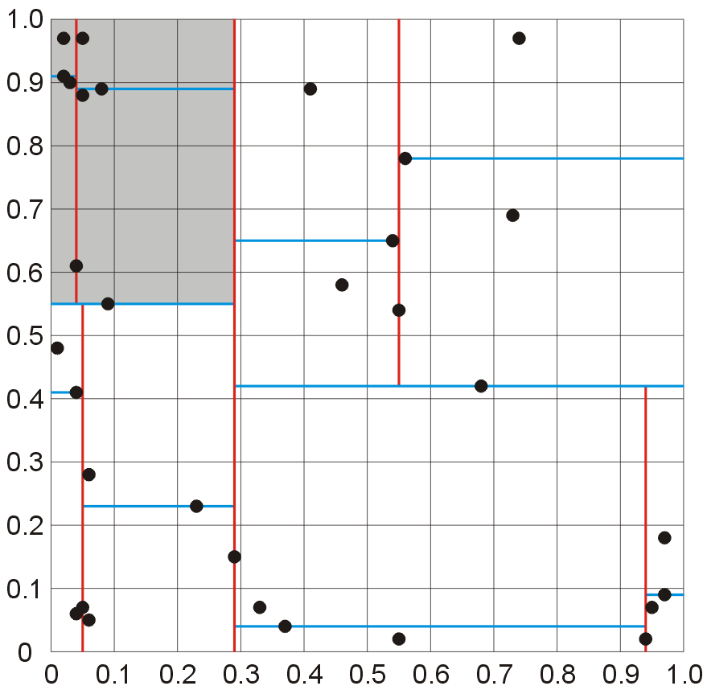
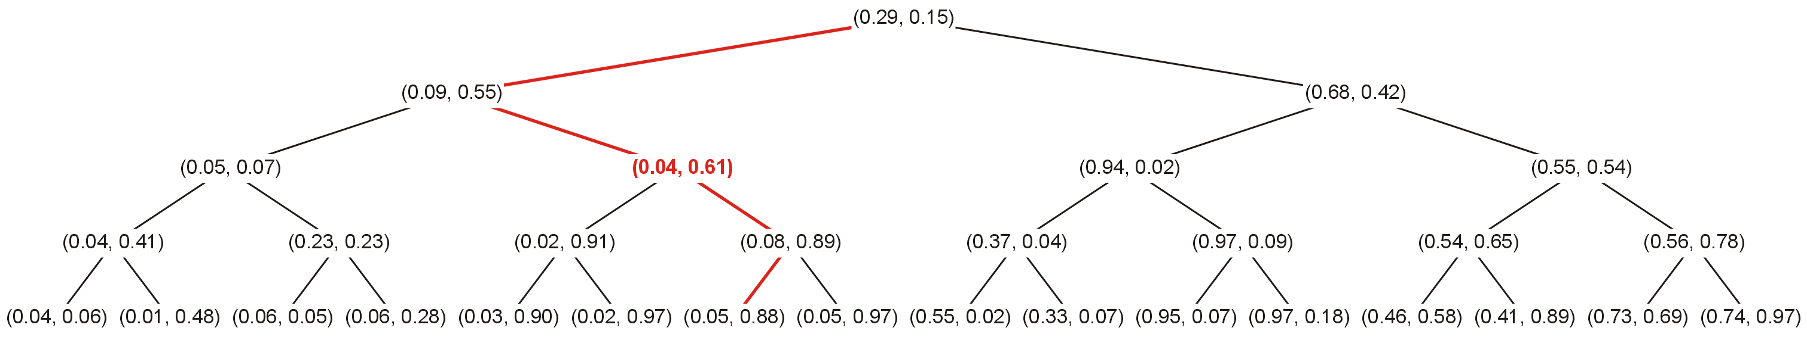
k-d trees
Moving down the tree, the points under (0.04, 0.61) are further restricted
This restriction is in the 2nd coordinate: [0, 0.29] × [0.55, 1]

Slide 28
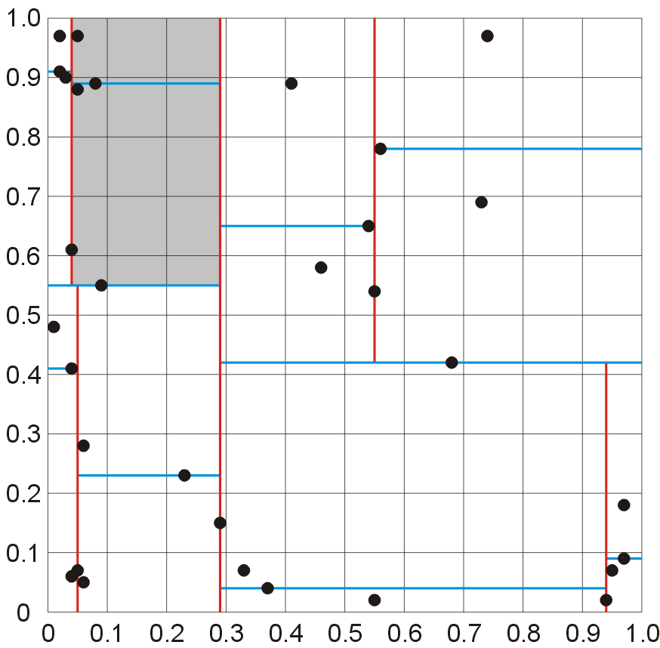
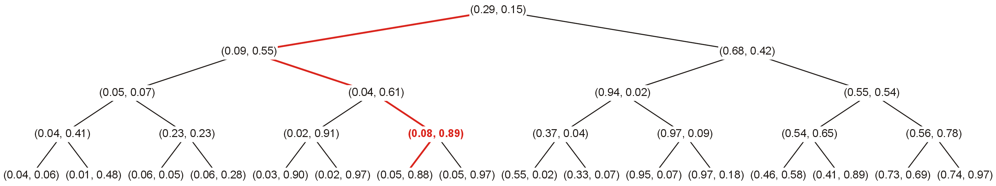
k-d trees
Stepping further down, all points below (0.08, 0.89) are again further restricted to [0.08, 0.29] × [0.55, 1]

Slide 29
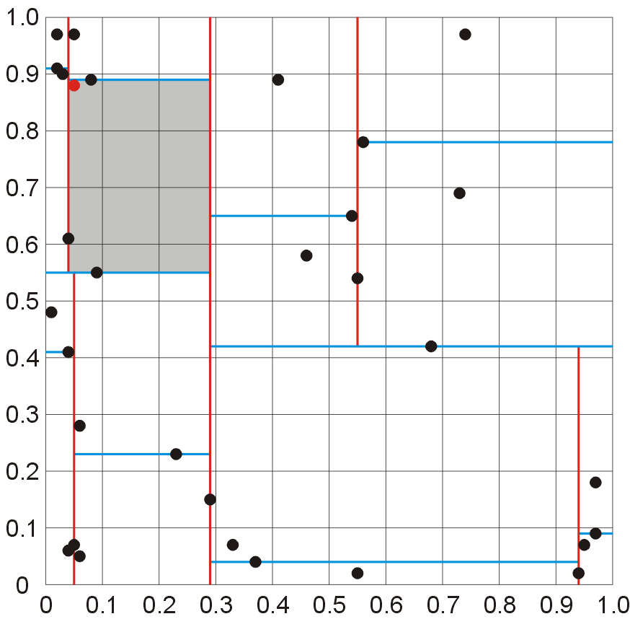
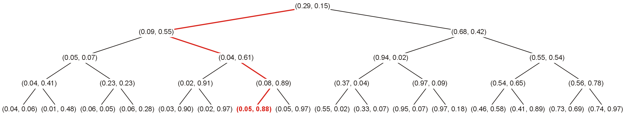
k-d trees
Finally, the last point, a leaf node, falls within the given box

Slide 30
k-d trees
A useful application of a k-d tree provides an efficient data structure for counting the number of points which fall within a given k-dimensional rectangle

Slide 31
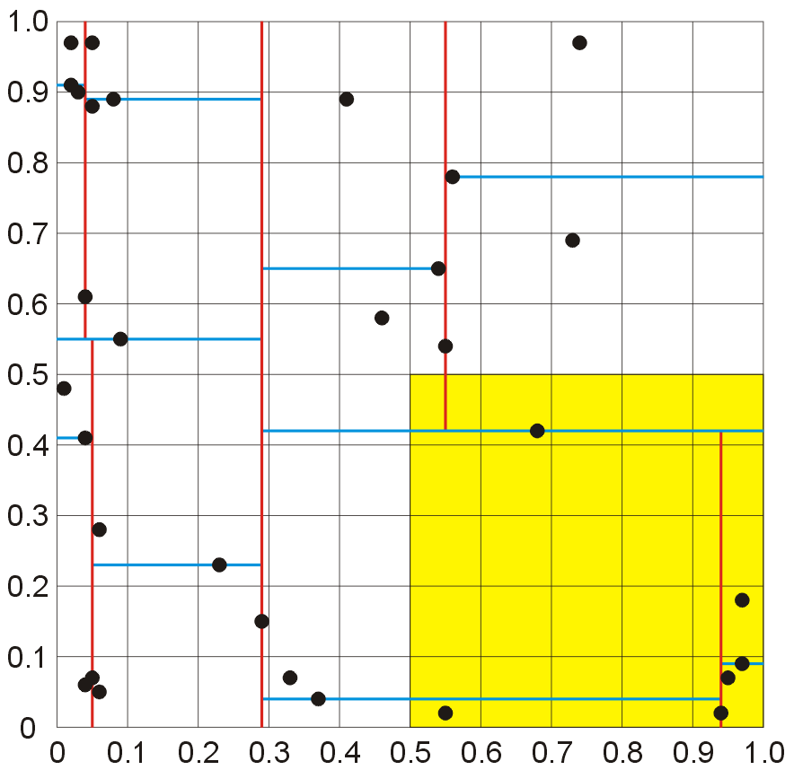
k-d trees
This is used in image processing: locating objects within a scene, ray tracing, etc.
Find the points which lie in the quadrant [0.5, 1] × [0, 0.5]

Slide 32
k-d trees
The traversal rules we will follow are:
we always match the coordinate corresponding to the level we are current at
if that coordinate is less than the corresponding interval of the box, we only need to visit the right sub-tree
if that coordinate is greater than the corresponding interval, we need only visit the left sub-tree
otherwise, we check if the root is in the box and we visit both sub-trees

Slide 33
k-d trees
There is one special case:
Because we can track the sub-interval under which a tree may fall, it may be possible to add an entire sub-tree

Slide 34
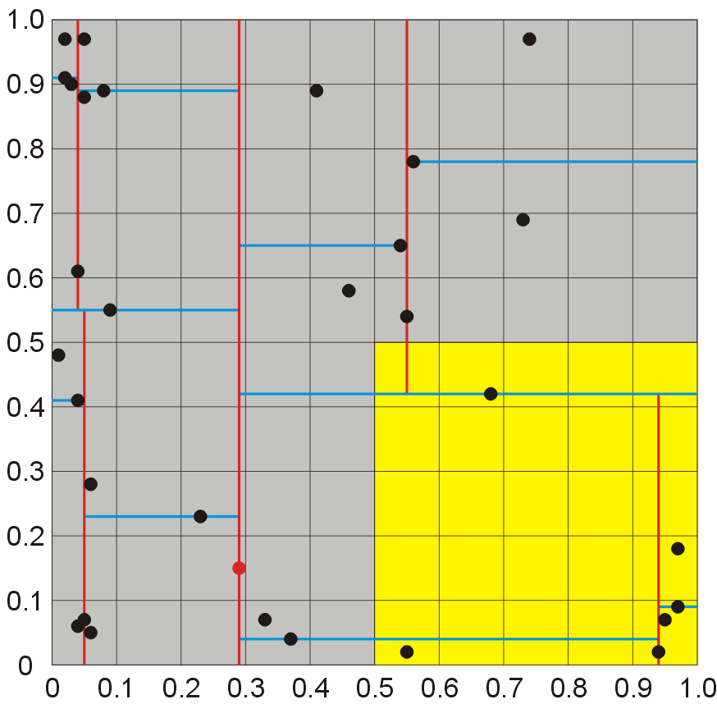
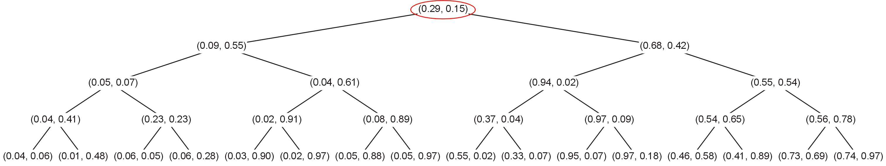
k-d trees
Starting at the root:
We examine the 1st coordinate
Note: 0.29 < [0.5, 1]
We visit only the right sub-tree

Slide 35
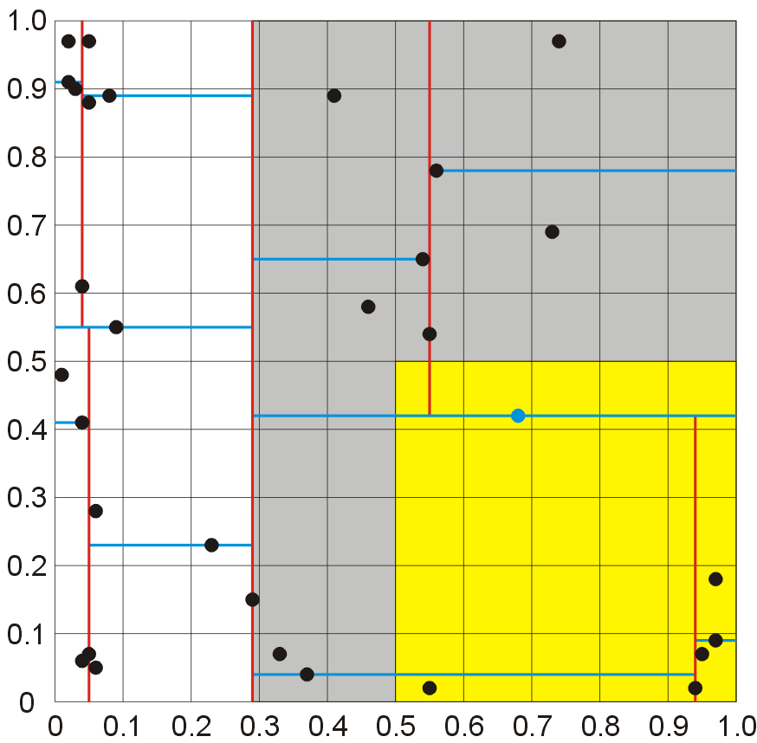
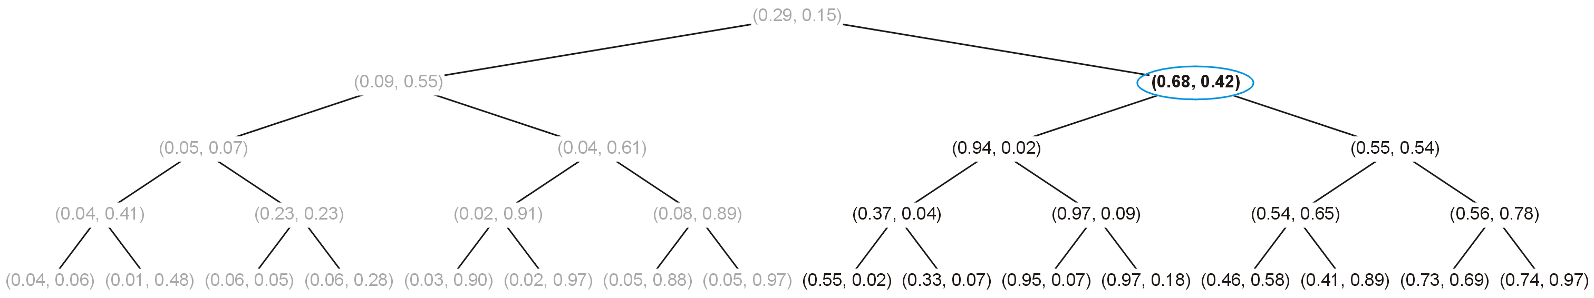
k-d trees
Visiting the right sub-tree: 0.42 ∈ [0, 0.5]
Also
(0.68, 0.42) ∈ [0.5, 1] × [0, 0.5]
and we visit both sub-trees

Slide 36
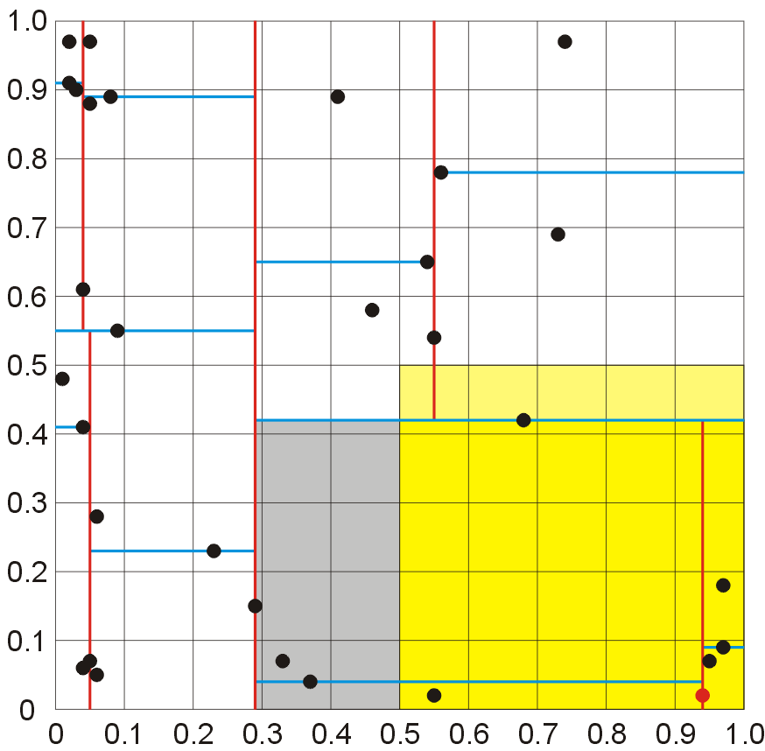
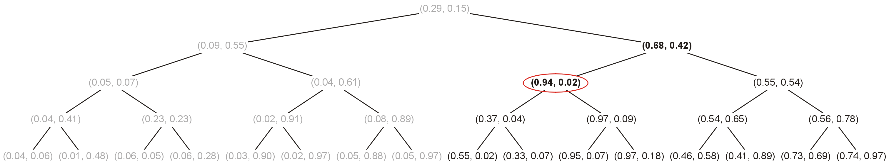
k-d trees
Starting with the left sub-tree: 0.94 ∈ [0.5, 1]
We note that
(0.94, 0.02) ∈ [0.5, 1] × [0, 0.5]
and we visit both sub-trees

Slide 37
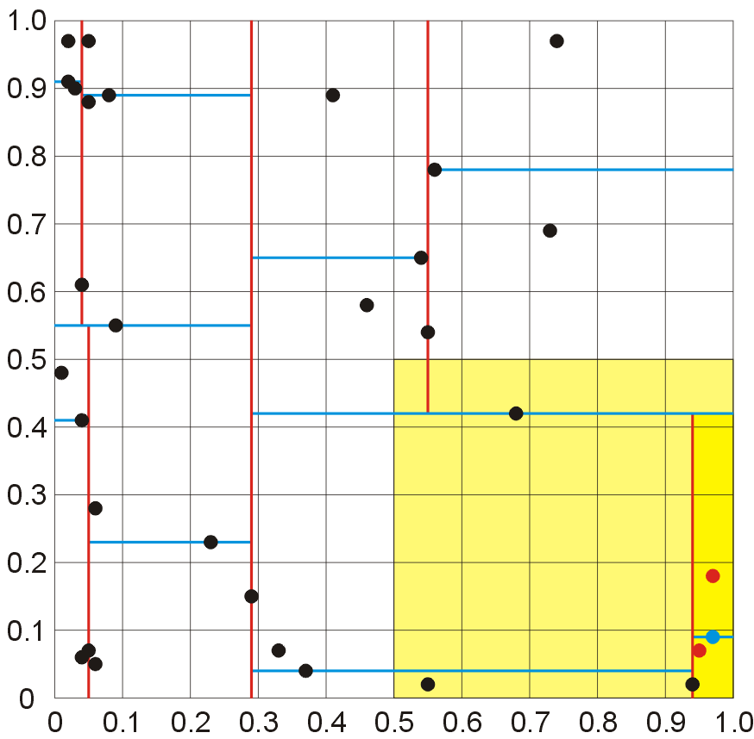
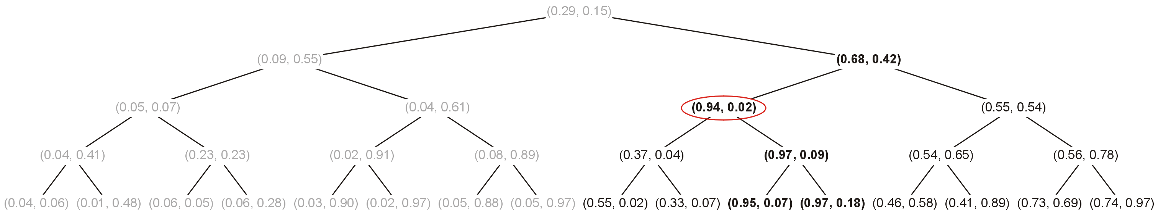
k-d trees
However, at this point, we notice that the right sub-tree is restricted to [0.94, 1] × [0, 0.42] and
[0.94, 1] × [0, 0.42] ⊆ [0.5, 1] × [0, 0.5]
Thus, the entire right sub-tree is in the box

Slide 38
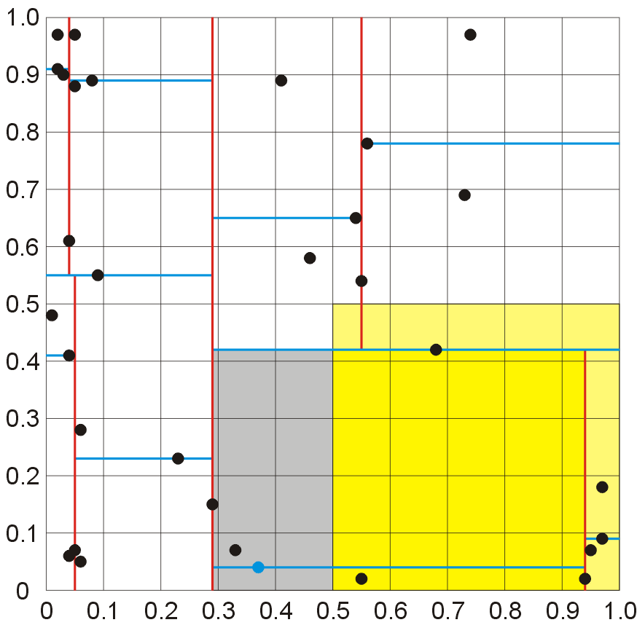
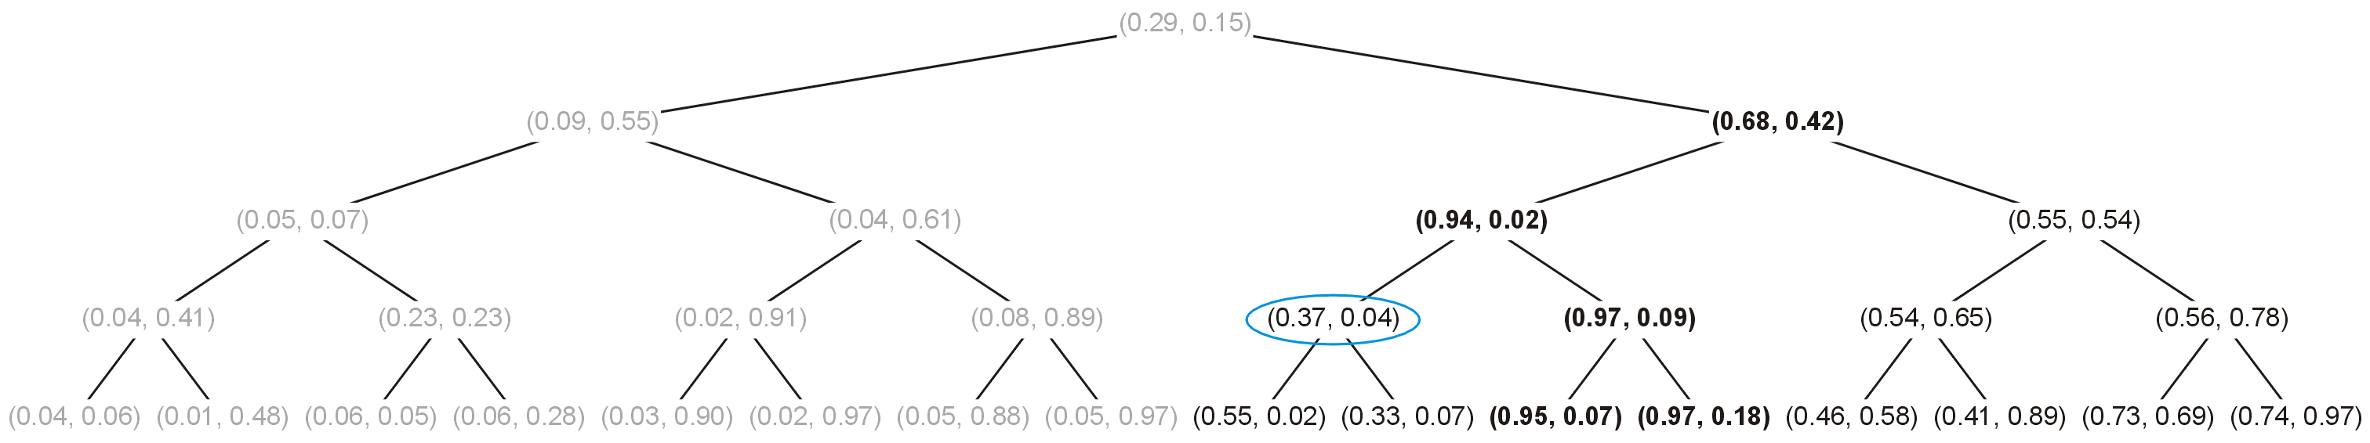
k-d trees
Continuing with the left sub-tree, we note that 0.04 ∈ [0, 0.5]
We note that
(0.37, 0.04) ∉ [0.5, 1] × [0, 0.5]
but we still visit both sub-trees

Slide 39
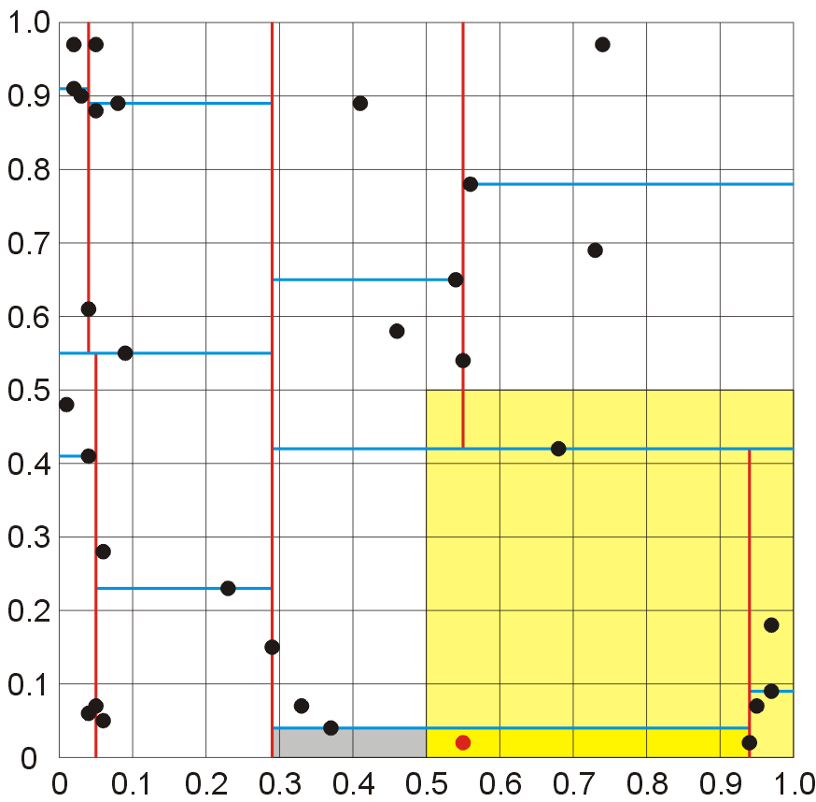
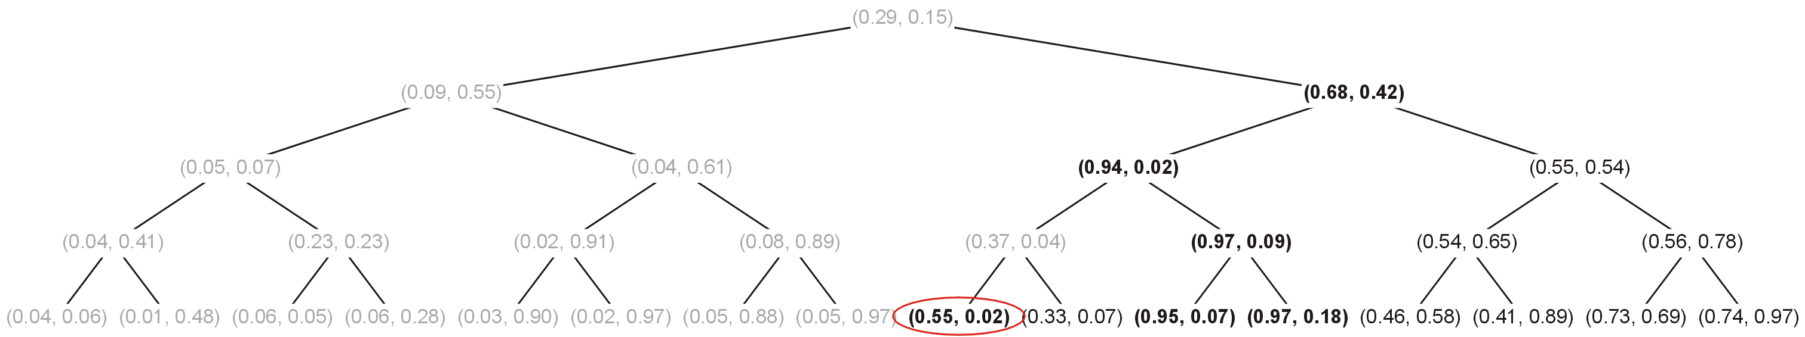
k-d trees
Inspecting the left leaf node
(0.55, 0.02) ∈ [0.5, 1] × [0, 0.5]
and we are finished

Slide 40
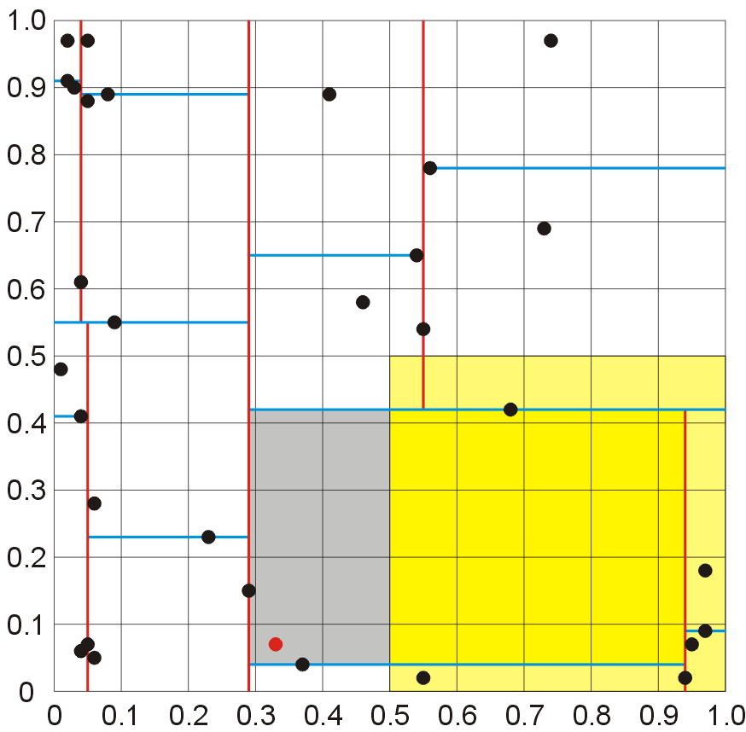
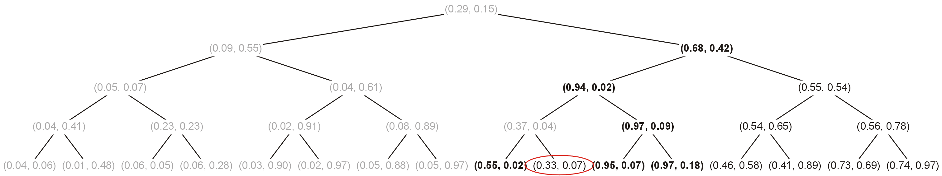
k-d trees
Inspecting the right leaf node, we note:
(0.33, 0.07) ∉ [0.5, 1] × [0, 0.5]
and we are finished

Slide 41
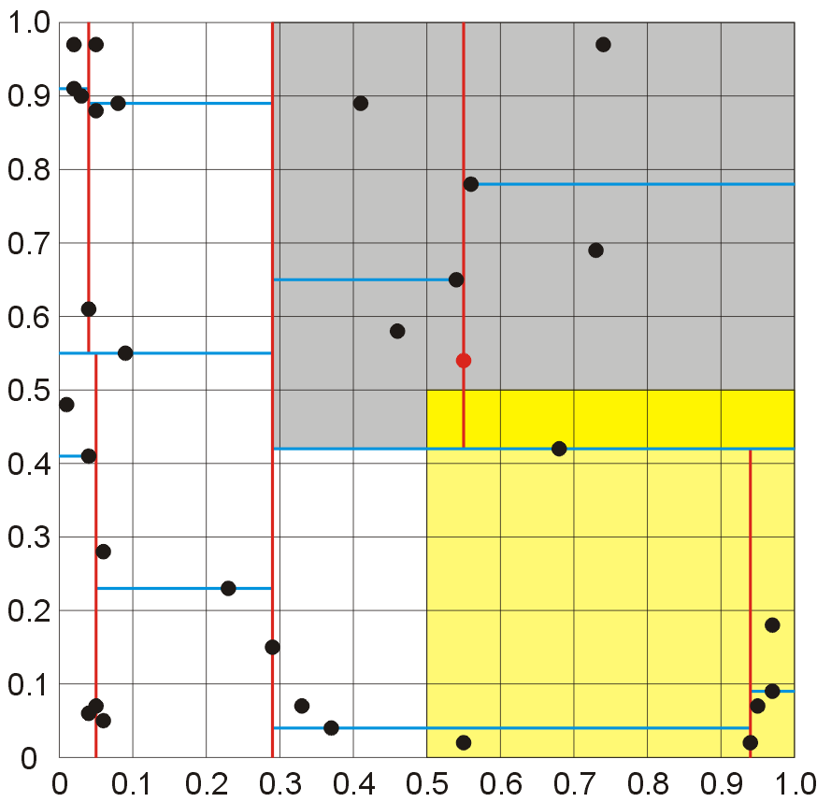
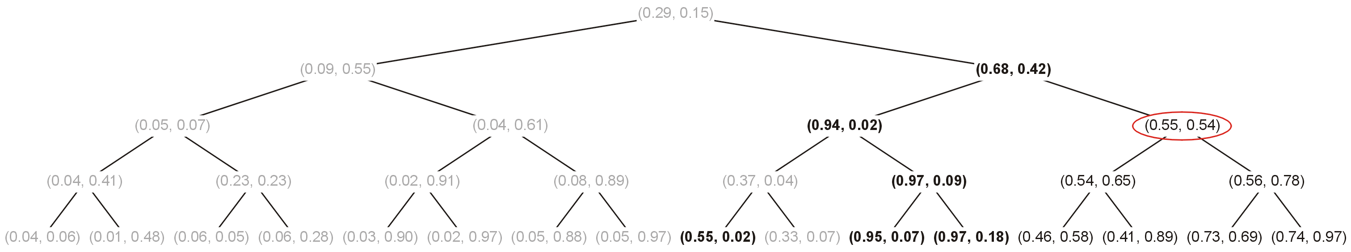
k-d trees
Continuing with the right sub-tree, we note that 0.55 ∈ [0.5, 1] (we must visit both sub-trees)
However, the point is not in the box
[0.5, 1] × [0, 0.5]

Slide 42
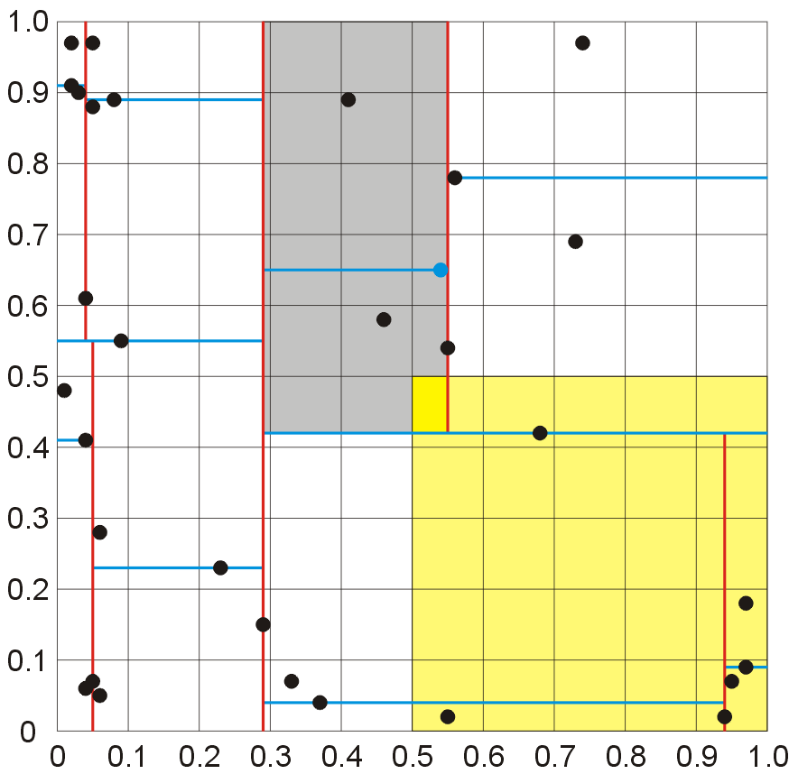
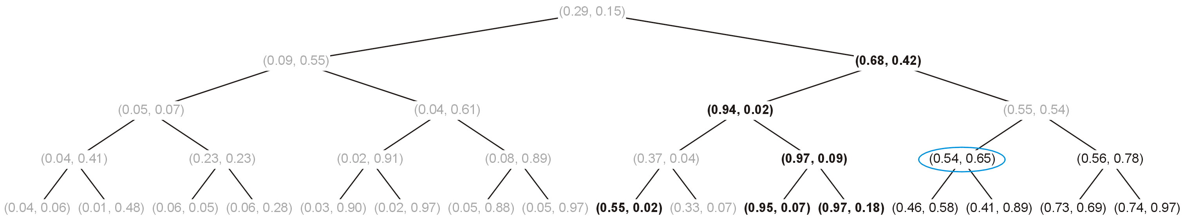
k-d trees
Visiting the next node, we note (0.54, 0.65) is not in the box and 0.65 > 0.5, hence we need only visit the left sub-tree

Slide 43
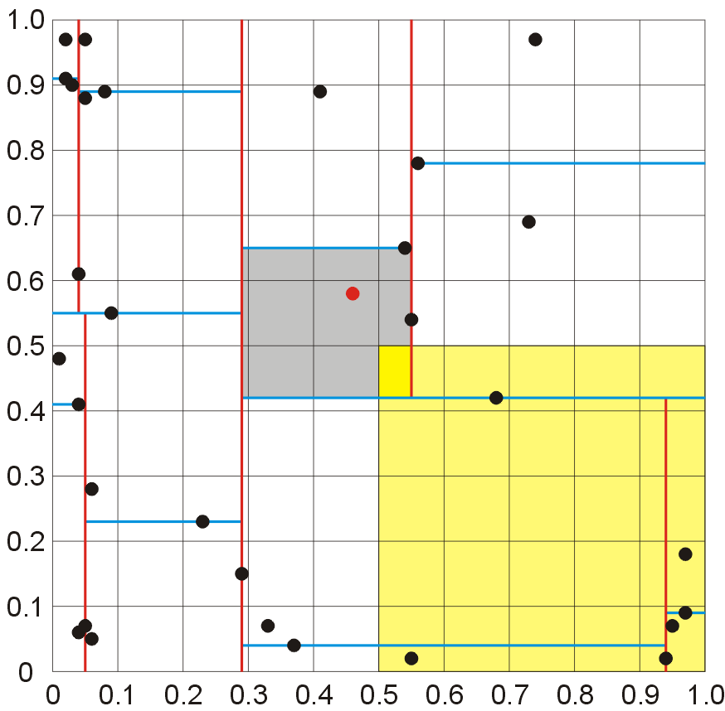

k-d trees
This leaf node is not in the region

Slide 44


k-d trees
Visiting the next node, we note (0.56, 0.78) is not in the box and 0.56 > 0.5, hence we need only visit the left sub-tree

Slide 45


k-d trees
This leaf node is not in the region
The traversal is finished

Slide 46

k-d trees
Thus, there are six points in the quadrant [0.5, 1] × [0, 0.5]
We had to visit fewer than half the points in the tree to determine this

Slide 47

k-d trees
Suppose we want to add a new element to an existing k-d tree
For example, add the point (0.15, 0.66) to the k-d tree which we just built:
we add the new element the same way we did with binary search trees, however, we must compare the appropriate coordinate at each level

Slide 48

k-d trees
First, we compare the first coordinate:
0.15 < 0.29
Thus we add the new element to the left sub-tree

Slide 49

k-d trees
Next, we compare the second coordinate:
0.66 > 0.55
Thus we add the new element to the right sub-tree

Slide 50

k-d trees
Next, we compare the first coordinate again:
0.15 > 0.04
Thus we add the new element to the right sub-tree

Slide 51

k-d trees
Next, we compare the first coordinate:
0.66 < 0.89
Thus we add the new element to the left sub-tree

Slide 52

k-d trees
Finally, we compare the first coordinate again:
0.15 > 0.05
Thus we add the new element as a new leaf node to the right

Slide 53

k-d trees
Thus, we have successfully added the point (0.15, 0.66) to the existing k-d tree

Slide 54
k-d trees
It is also a reasonably fast algorithm to find a point’s nearest neighbour
The nearest neighbour is a point which is closest to, but not equal to the given node
first we search as if we are performing an insertion, but
we may have to back up the tree until we ensure that neighbouring regions may not have a point closer

Slide 55
k-d trees
Removing elements is more difficult, as we must maintain the structure
Finding the “largest element” with respect to a particular coordinate may be very difficult

Slide 56

k-d trees
For example, consider removing the root node from the k-d tree we previously constructed:
We note:
the minimum element in the right sub-tree is not in the obvious location, and
neither is the maximum element in the left sub-tree...

Slide 57
k-d trees
It may be easier to flag removed nodes as being “deleted” and leave the tree unchanged otherwise
With numerous removals, this may significantly increase the run time of other operations...

Slide 58
k-d trees
Balancing k-d trees is much more difficult than balancing AVL trees
You cannot perform rotations in the same way in which rotations are performed with AVL trees

Slide 59

k-d trees
Consider the following naïve rotation
We will rotate (2, J) to the root and we reattach nodes (4, M) and (6, F) as appropriate, as well as two sub-trees

Slide 60
k-d trees
Unfortunately, tree A may have:
elements less than 2, and
if non-empty, all elements are greater than M

Slide 61
k-d trees
Similarly, tree B may have:
has all elements greater than 6 (good), but
there is no restriction which guarantees that the elements are all < M or all > M

Slide 62
k-d trees
The use of k-d trees is not only restricted to 2d, 3d, or higher dimensional spaces
Consider the following problem:
suppose we have a database of phone numbers of individuals within a particular province
find all individuals 20 km from some point who are between the ages of 19 and 32
we could design a 3-dimensional k-d tree based on the three coordinates (x, y, age)

Slide 63
k-d trees
The previous example introduces an interesting problem: 20 km from some point is a circular region
k-d trees can only detect boxed regions
thus, we find the smallest bounding box of the region, find all points in the box, and select those within the region

Slide 64

k-d trees
Suppose we wish to find all Blackberry users within UW east of Westmount Dr.

Slide 65
k-d trees
In the example, we started with a given set and by using the median, we arrived at a balanced tree
If we are adding or removing points, we may require rotations to keep the tree balanced
These rotations are more complex than rotations for, say, an AVL tree

Slide 66
k-d trees
In this topic, we have covered red-black trees
Simple rules govern how nodes must be distributed based on giving each node a colour of either red or black
Insertions and deletions may be performed without recursing back to the root
Only one bit is required for the “colour”
This makes them, under some circumstances, more suited than AVL trees

Slide 67
References
[1] Weiss, Data Structures and Algorithm Analysis in C++, 3rd Ed., Addison Wesley, §12.6, p.549-53.

Slide 68
Usage Notes
These slides are made publicly available on the web for anyone to use
If you choose to use them, or a part thereof, for a course at another institution, I ask only three things:
that you inform me that you are using the slides,
that you acknowledge my work, and
that you alert me of any mistakes which I made or changes which you make, and allow me the option of incorporating such changes (with an acknowledgment) in my set of slides
Sincerely,
Douglas Wilhelm Harder, MMath
dwharder@alumni.uwaterloo.ca

